Slide 1


Online examination system

Slide 2

ABOUT
WHAT IS THE IDEA ABOUT?

Slide 3

IDEA OF THE PROJECT
The idea is to create an online platform for the students to test their knowledge
An online exam provides flexibility and security to the examination process. Once all the questions are uploaded in the system, the system can shuffle and give questions in different orders to different students.

Slide 4

OVERVIEW

Slide 5
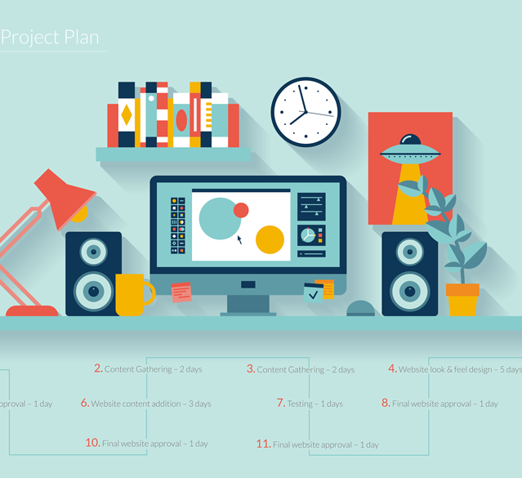
CONCEPT
DESGINING
DATABASE
CONNECTIVITY
FUNCTIONALITY

Slide 6

DESIGNING
Desigining is the backbone of every project without designing it is not possible to make the projects look good. For the designing of our project we've used some most common languages and libraries such as html, css and bootstrap. Html was used to build the structure of the website. We've added bootstrap for using its pre defined libraries of css and java script and used another css files apart from bootstrap css for doing some custom designing in our website.

Slide 7

FRONT PAGE

Slide 8


LOG-IN

Slide 9
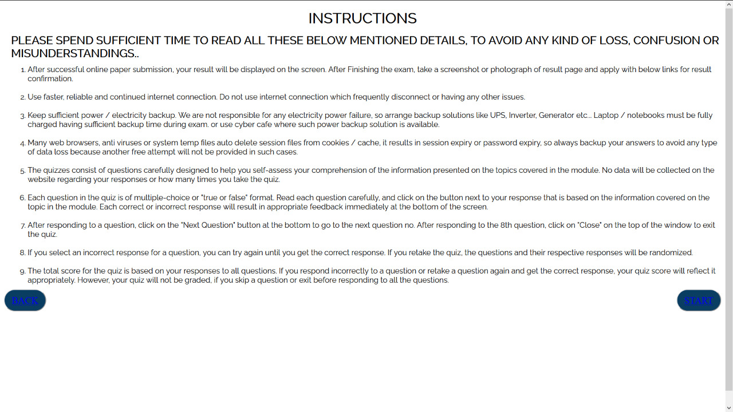
INSTRUCTIONS

Slide 10



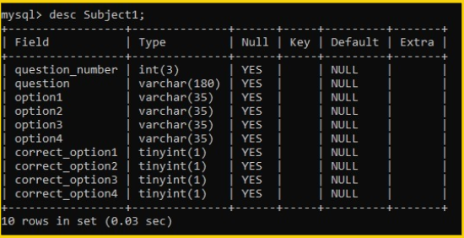
DATABASE AND CONNECTIVITY
DATABASE
CONNECTIVITY
XAMPP
XAMPP is a open-source cross-platform web server solution stack used for database storage and interpreting php.
PHP was used to connect front-end with back-end.

Slide 11



FUNCTIONALITY
JAVASCRIPT
JavaScript is an object orient programming language designed to make web development easier and more attractive.
JavaScript is used to create responsive, interactive elements for web pages, enhancing the user experience.
Vue.js is an open-source model–view–view model JavaScript framework for building user interfaces and single-page applications.

Slide 12
WORKING
For using the quiz application, the user has to register himself/herself or log-in into his account. The user can give the quiz in two subject variety:
SOFTWARE ENGINEERING
OPERATING SYSTEM
DATA STRUCTURES
This test should be completed in time limit of one hour.

Slide 13
PROBLEM STATEMENTS
Database
PHP connectivity
Designing.
Data Backup And Application Security.

Slide 14
Future upgradation:
Better Database.
Website Security
Data backup
Admin portal
Images in questions

Slide 15
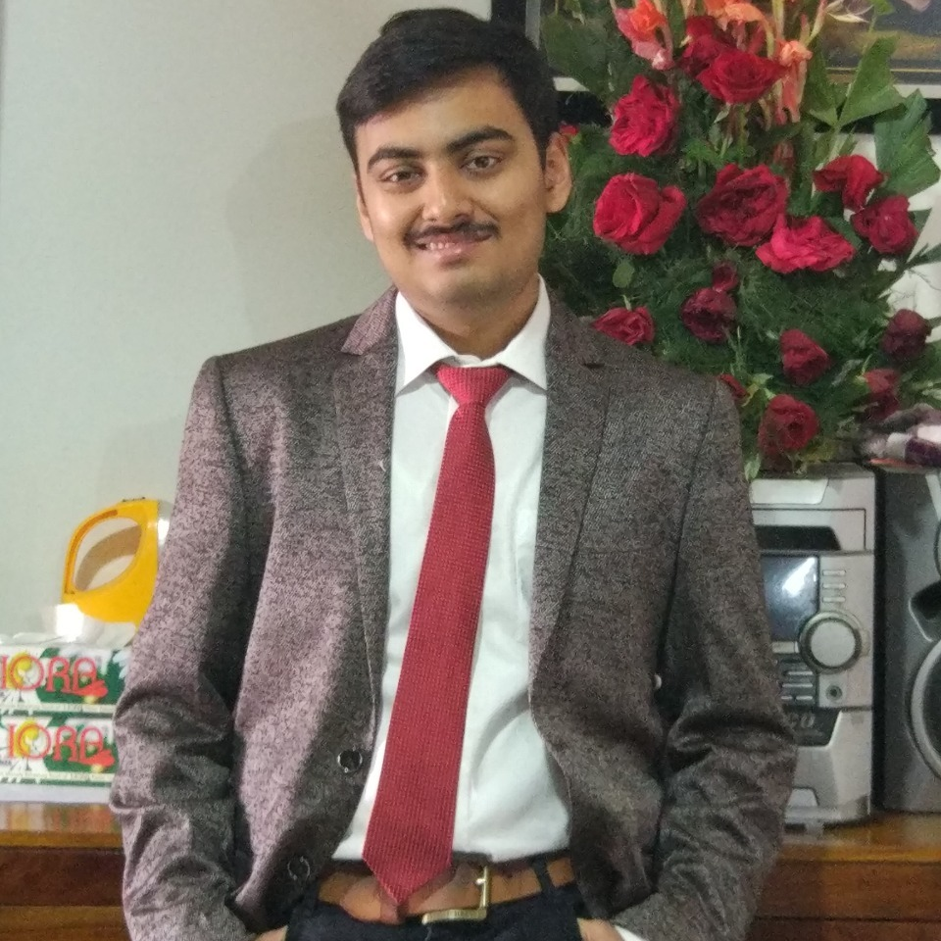
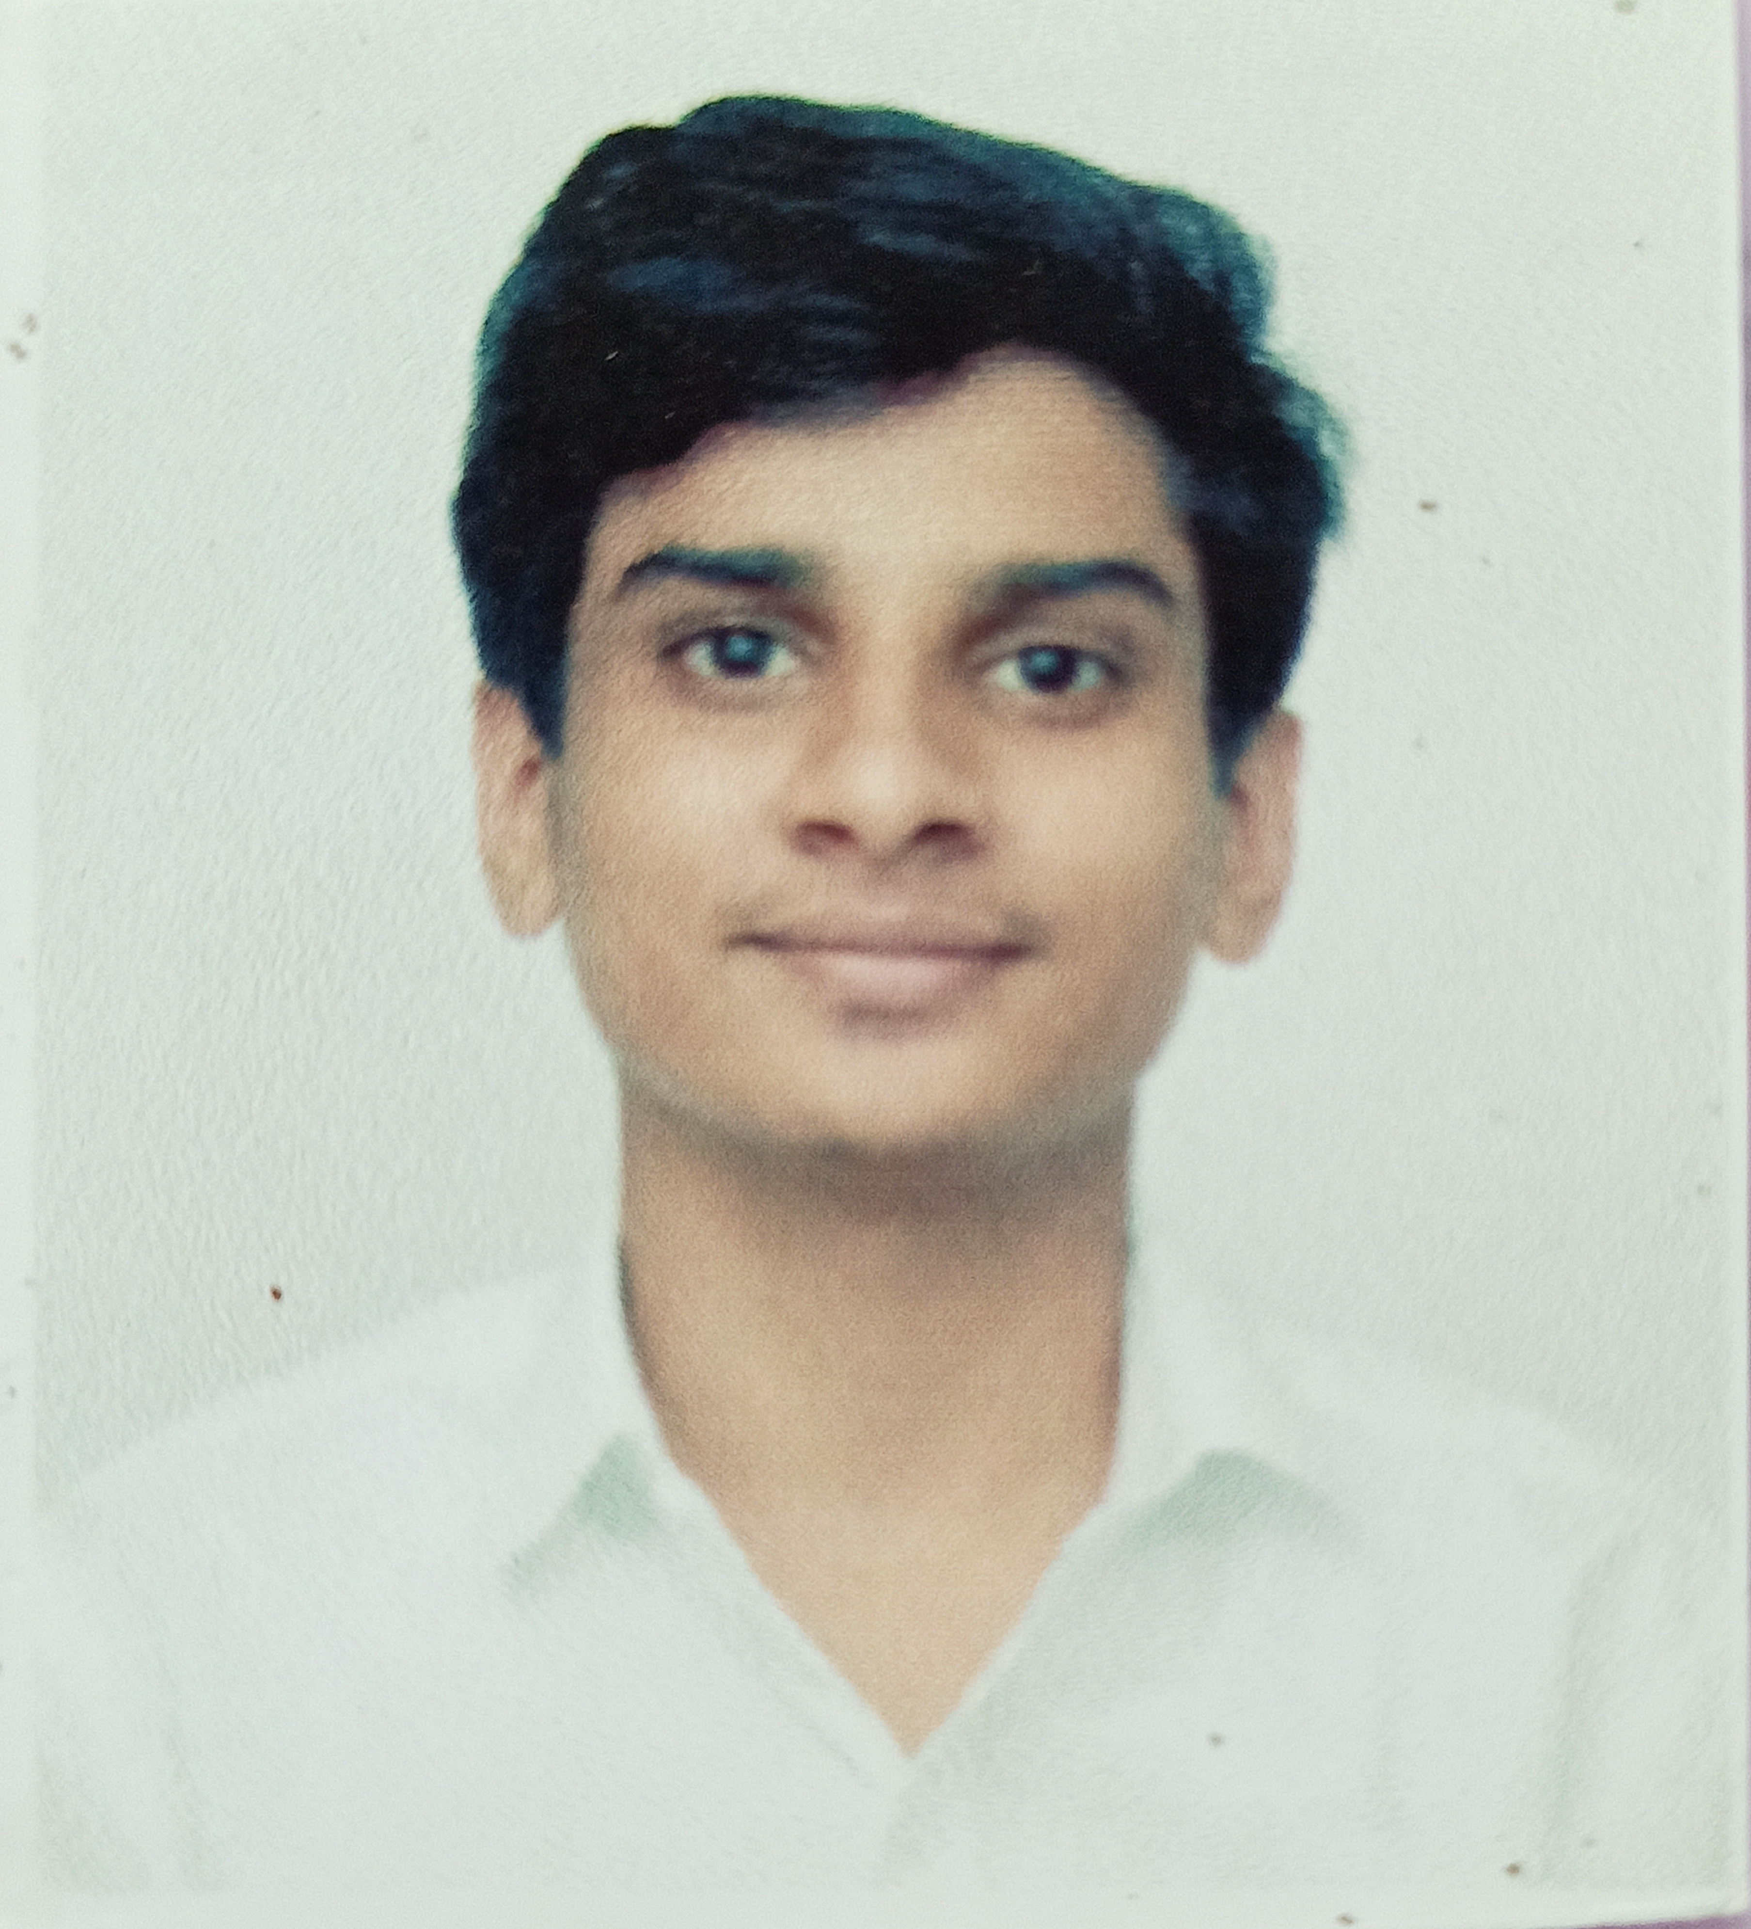
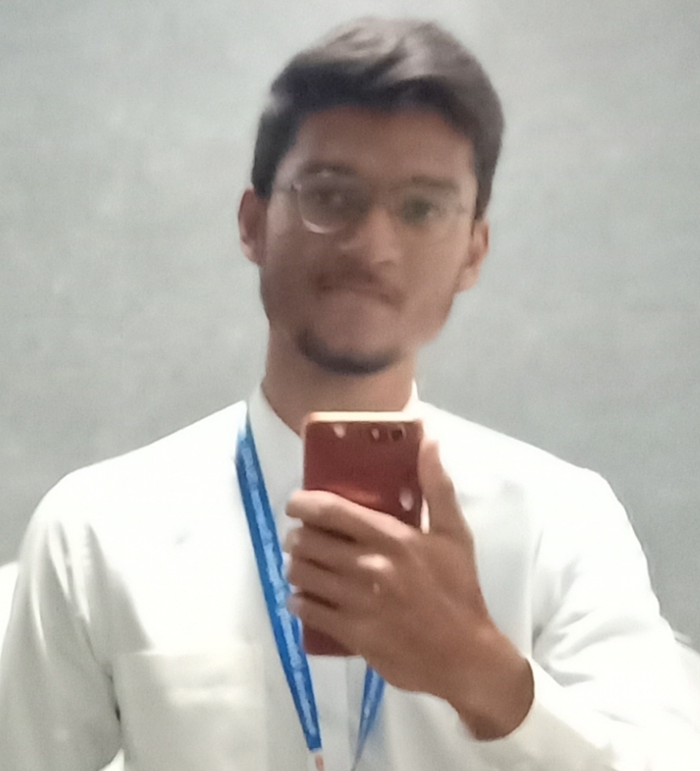

team
ARYAN SAHU
ASHISH SINGH SENGAR
AZIZ SOGIYAWALA
CHARUDATTA PADHYE
Contributed as a full-stack developer in the project
Contributed as the co-full stack developer in the project
Contributed as a front-end developer in the project
Contributed as the Project Manager and in SRS Documentation as well as the presentation of the project.

Slide 16

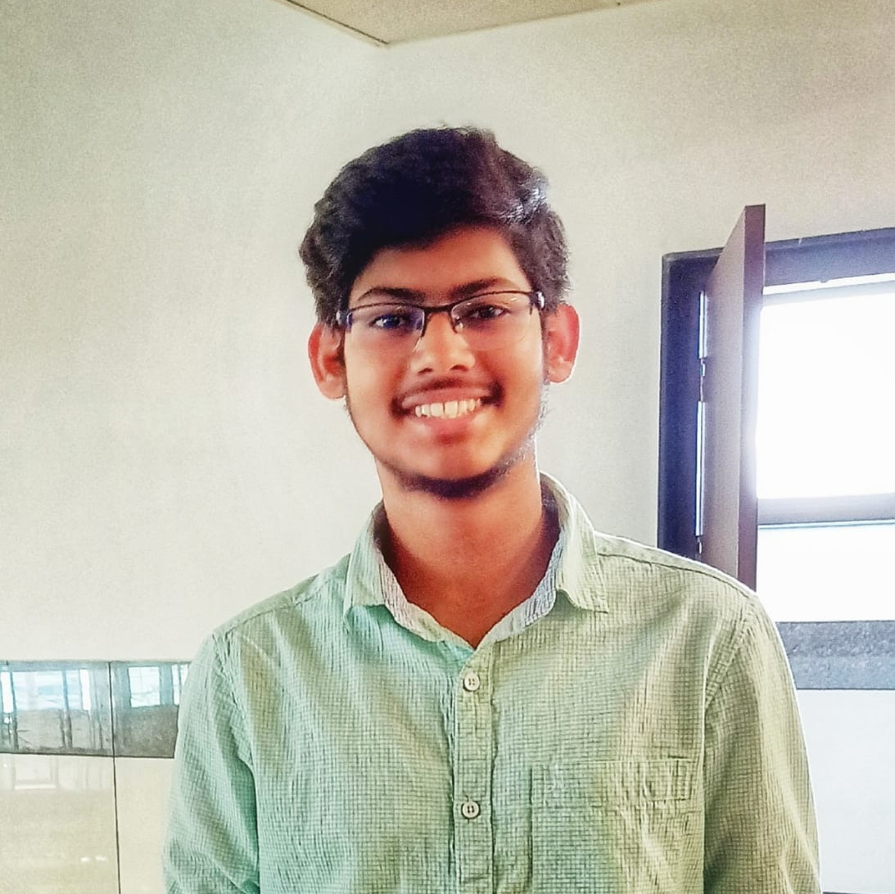
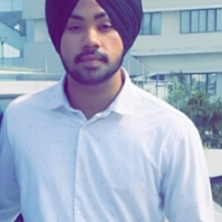

TEAM CONTD.
AYUSH JAISWAL
ATEEB ASHFAQUE
ARSHPREET SINGH BHATIA
Contributed in Query optimization in the project
Contributed in the security of the web-app project as well as SRS documentation
Contributed in the Data Scraping of the project

Slide 17


Thank you!

